Slide 1
Exploratory Data Analysis: Flight Prices
Done by Ga fellows:
Yusuf AlDamami
Kahdija Khamis
Ahmed AlSaeed

Slide 2

Project Overview
Objective: Uncovering pricing patterns and actionable insights from Expedia flight data in May 2022.
Focus: Top airports, day of the week effects, fare class, direct vs connecting, luxury vs economy.

Slide 3

Info of the data available
5 million flight records collected from Expedia from Kaggle
Focused EDA on May 2022 2.87M flights
Coverage: All U.S. domestic flights
Mean Base Fare: $303.20
Mean Total Fare: $351.63
Median Base Fare: $273.49

Slide 4

Next up Exploratory Data Analysis
With a large focus on the month of May

Slide 5
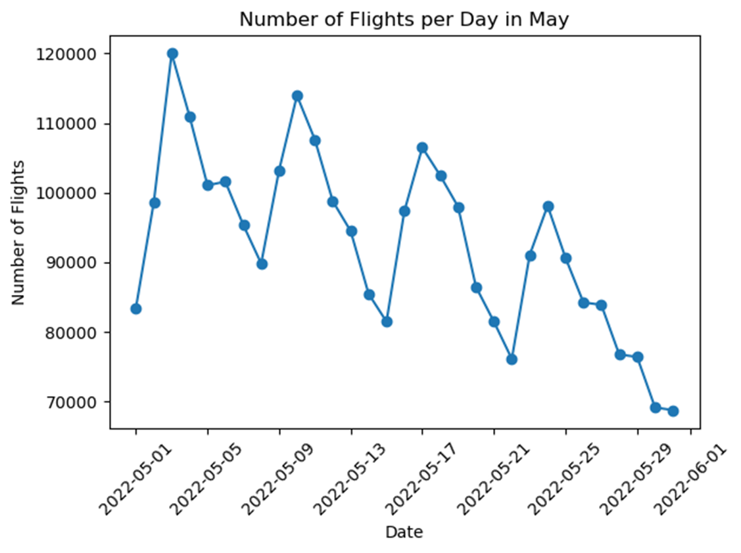
Bi-Weekly Flight Departures
Notes:
Original chart from notebook: top airports by departures.

Slide 6
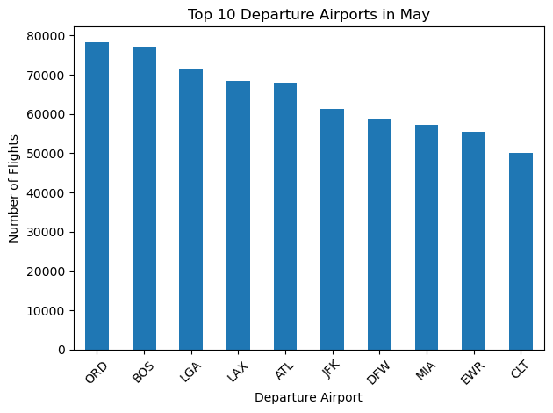
Most popular airports

Slide 7
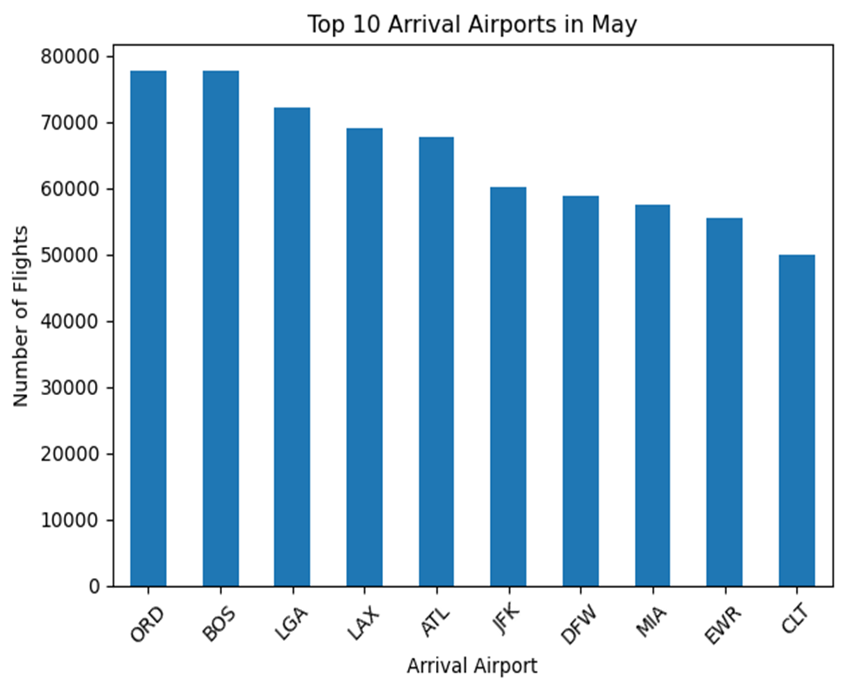
Top performing airports in may

Slide 8
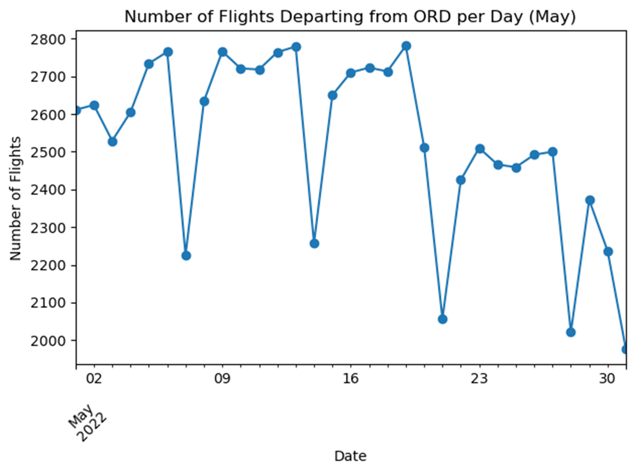
Non-stop vs Connecting flights

Slide 9
Top Flight Dates Volume (week)

Slide 10
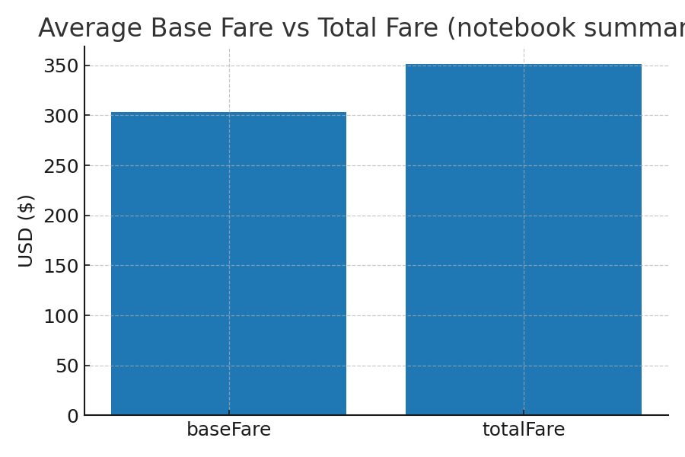
Average Base Fare vs Total Fare

Slide 11
Key insights:
ATL is a dominant departure hub with many low-priced options (notebook analysis).
Mid-week flights (Tue–Thu) tend to be cheaper and in weekends prices increase for work related flights.
Basic Economy is the cheapest option and refundable, non-economy tickets are a 30–50% pricier.
Non-stop flights are 15 to 25% more expensive but save on time so travelers can choose cost vs convenience.
Recommendations:
Book mid-week where possible and prefer basic economy for cost savings on non-essential trips.
Airlines should optimize weekend pricing and consider targeted promotions for off-peak times like the middle of the week.
Insights
And
Responses

Slide 12

Thank you for listening 😊 Any questions?

